Slide 1
VISUAL C#.NET session 21
Instructor: Edwin oduor

Slide 2

Quote of the day

Slide 3
Lesson objectives
Create C# Application
Link the Application to a Data Base
Interacting with the Data base through C# GUI Application

Slide 4
Lesson pre-requisites
In order to take full advantage of this section you need to have the following;
Computer with Visual Studio Installed.
Stable Network Connection.

Slide 5
Training methods and extra readings
TRAINING METHODS FOR THIS LESSON
EXTRA READINGS
Lecturing Method – This is the main method of training to be adopted in this lesson with illustrations and practical coding examples.
Discussion Method - This method will be adopted periodically whereby learning will be derived principally from the students brainstorming together, rather than from the trainer. Three main types of discussions will be used:
Directed discussion
Developmental discussion
Problem-Solving discussion
Home and Learn C#

Slide 6
Create c# application

Slide 7
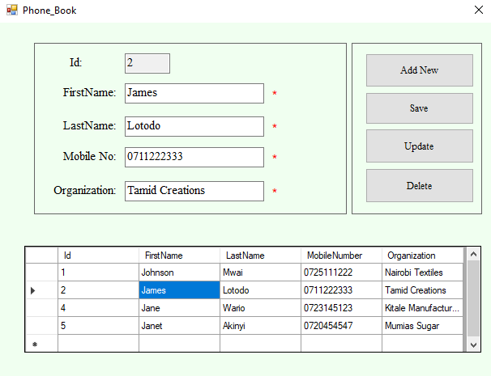
This is what we will create, through this we will be able to understand how to perform CRUD Operations in C#, how to retrieve data and display on the form and many more.

Slide 8
Connecting to db
Before connecting to the database, one needs to import the following,
Connecting to the Database and Retrieving Data
To connect to the database, then this code is used.
A
C
B
A – The part marked A is where we are getting the data from, in this case the data source is from a local database hence using (.) dot.
B- The part marked B is the name of the database, one has to specify the name of the database one intends to connect to.
C – integrated security

Slide 9

Connecting to db contd..
The next line is shown above, in this line to retrieve contents of the table then will use SqlCommand, then Sql statement to retrieve all the contents of the table and also the first line of code is passed in the SqlCommand.
Afterwards connections is going to be opened and execution is going to take place.

Slide 10
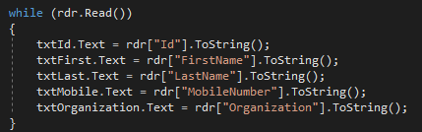
Connecting to db contd..
Will use a while loop, the contents that have been retrieved from the table will be displayed in the respective text boxes.
The entire code to connect to the database and retrieve connect and eventually display in the textboxes is shown below. The code is inside a method called showData, then the method is called in the form load event.

Slide 11
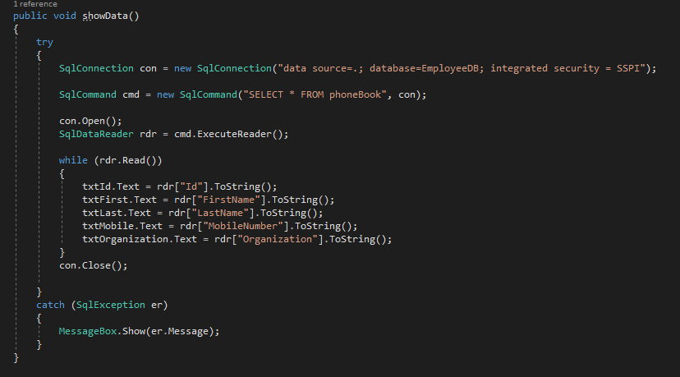
Connecting to db contd…

Slide 12
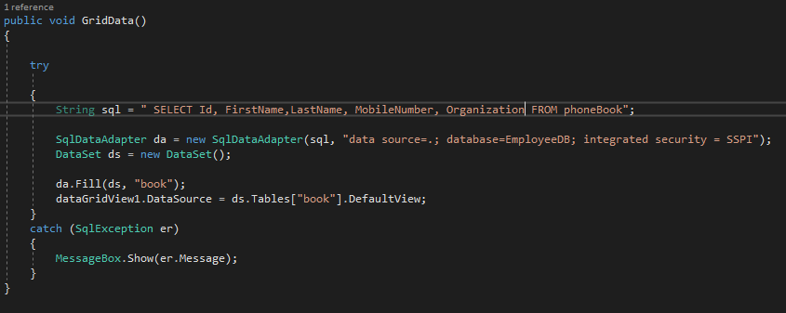
Connecting to db contd…
To display contents of the database in the data grid then the following code has been used, the code is inside a method called GridData the same is going to be called in the form load event.

Slide 13
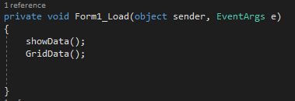
Connecting to db contd…
This is how the two methods are called in the form load event.

Slide 14
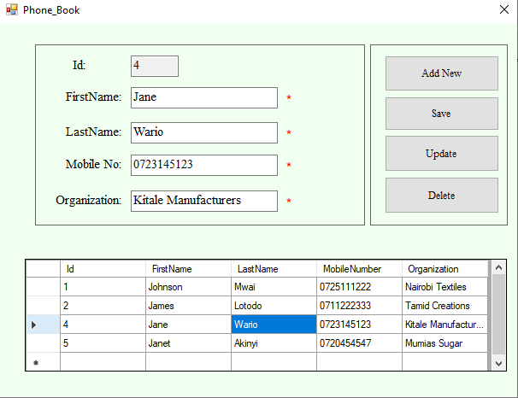
If a record is clicked on in the data grid, then the same record’s data is displayed in the text box, for instance the record that has been clicked on is record for Jane the same is being displayed in the text boxes.

Slide 15
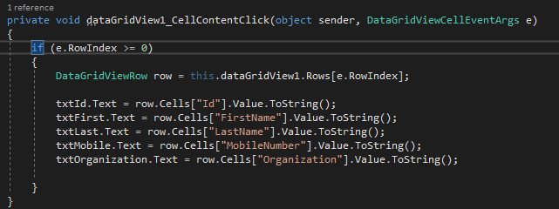
To achieve this the code has to be written in the data grid by double clicking on it, then write code where the cursor is blinking.

